Slide 1
How to use LLMs?
- By Siwen Wang

Slide 2
Preface
This is a comprehensive guide covering the usage of Large Language Models (e.g. ChatGPT, Claude, DeepSeek).
Original credit goes to Andrej Karpathy (https://www.youtube.com/watch?v=EWvNQjAaOHw), I just summarize his words in this slides. Since in the post Tik-tok era, not many people still have the patience to watch a 2-hour long video anymore

Slide 3
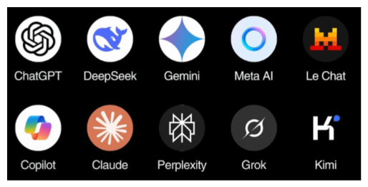
List of Common LLMs
The Founder of all:
ChatGPT (OpenAI, U.S.)
Big tech:
Gemini (Google, U.S.)
Meta AI (Meta, U.S.)
Doubao (ByteDance, China)
Startups:
Claude (Anthropic, U.S.)
Grok (xAI, U.S.)
DeepSeek (China)
Perplexity (U.S.)

Slide 4
Common Things about LLM
1. LLMs have it’s working memory in the same chat window, it will remember what you said earlier (to an extent) and provide answers based on the context. So if your topic is continuous, stay in the same chat window, however, if you change topic, it is recommended to start fresh in a new window.
2. Different LLMs have different model versions: some are more capable (i.e. smarter), some are faster but not as smart, some offer you additional capabilities such as image understanding etc. You should choose based on your need. If unsure, stay with the default.

Slide 5
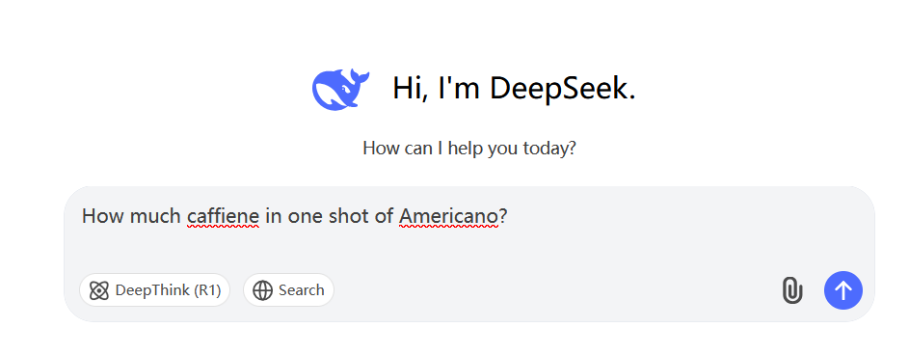
LLM as an Assistant
The most basic usage: type your queries in the chatbox and get an answer immediately
Best for:
1. Common factual questions
Not good for:
1. Recent things (it doesn’t know)
2. Math and Science questions (it does not do well)

Slide 6
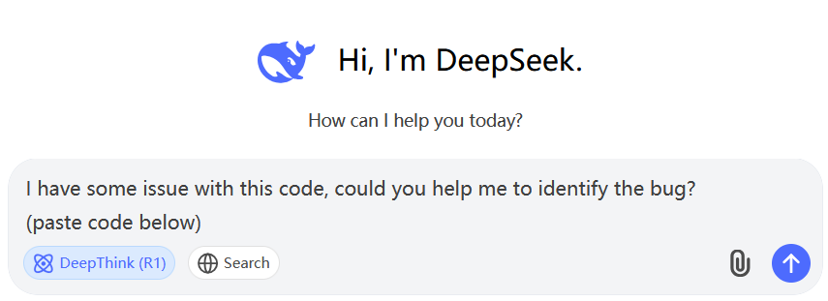
LLM as STEM Problem Solver
Some LLMs have the “thinking” capability (ChatGPT o1, DeepSeek R1, Claude 3.7), it can be used to solve more complex questions
Best for:
1. Math, science questions that require complex reasoning skills
2. Programming problems (debugging)
Not good for:
1. Recent things (it doesn’t know)

Slide 7
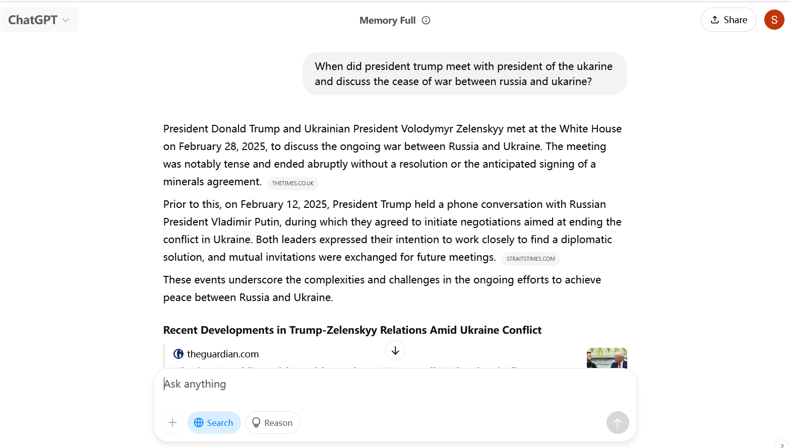
LLM as a search engine
Some LLMs have tool use such as searching the internet. It will browse the pages on its own and give you a summary of the content
Best for:
1. Recently things

Slide 8
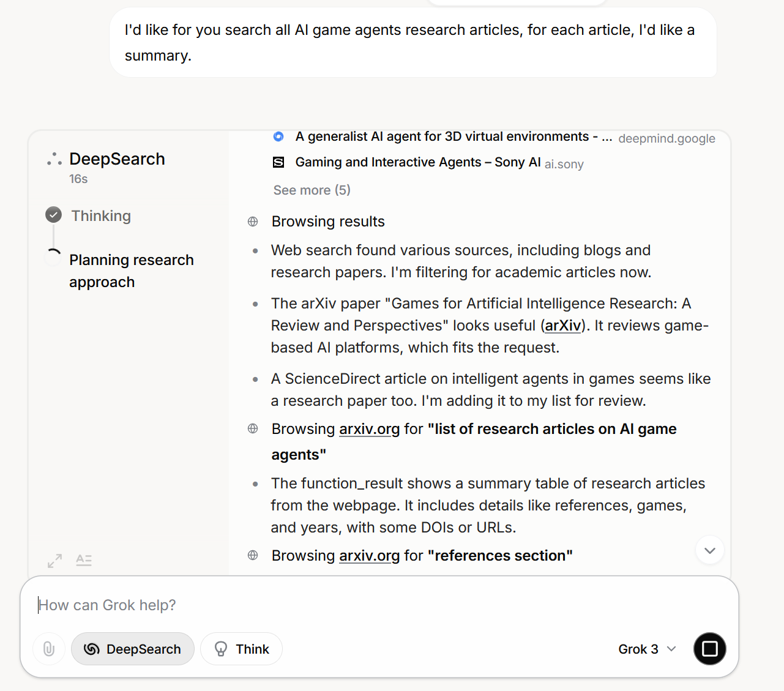
LLM as a research assistant
Some LLMs have the feature “deep research”, which it combines search and thinking, this can often go quite long (>10 minutes), and it will generate a long report at the end
Best for:
1. Research questions, very convenient on
gathering papers related to your interest

Slide 9
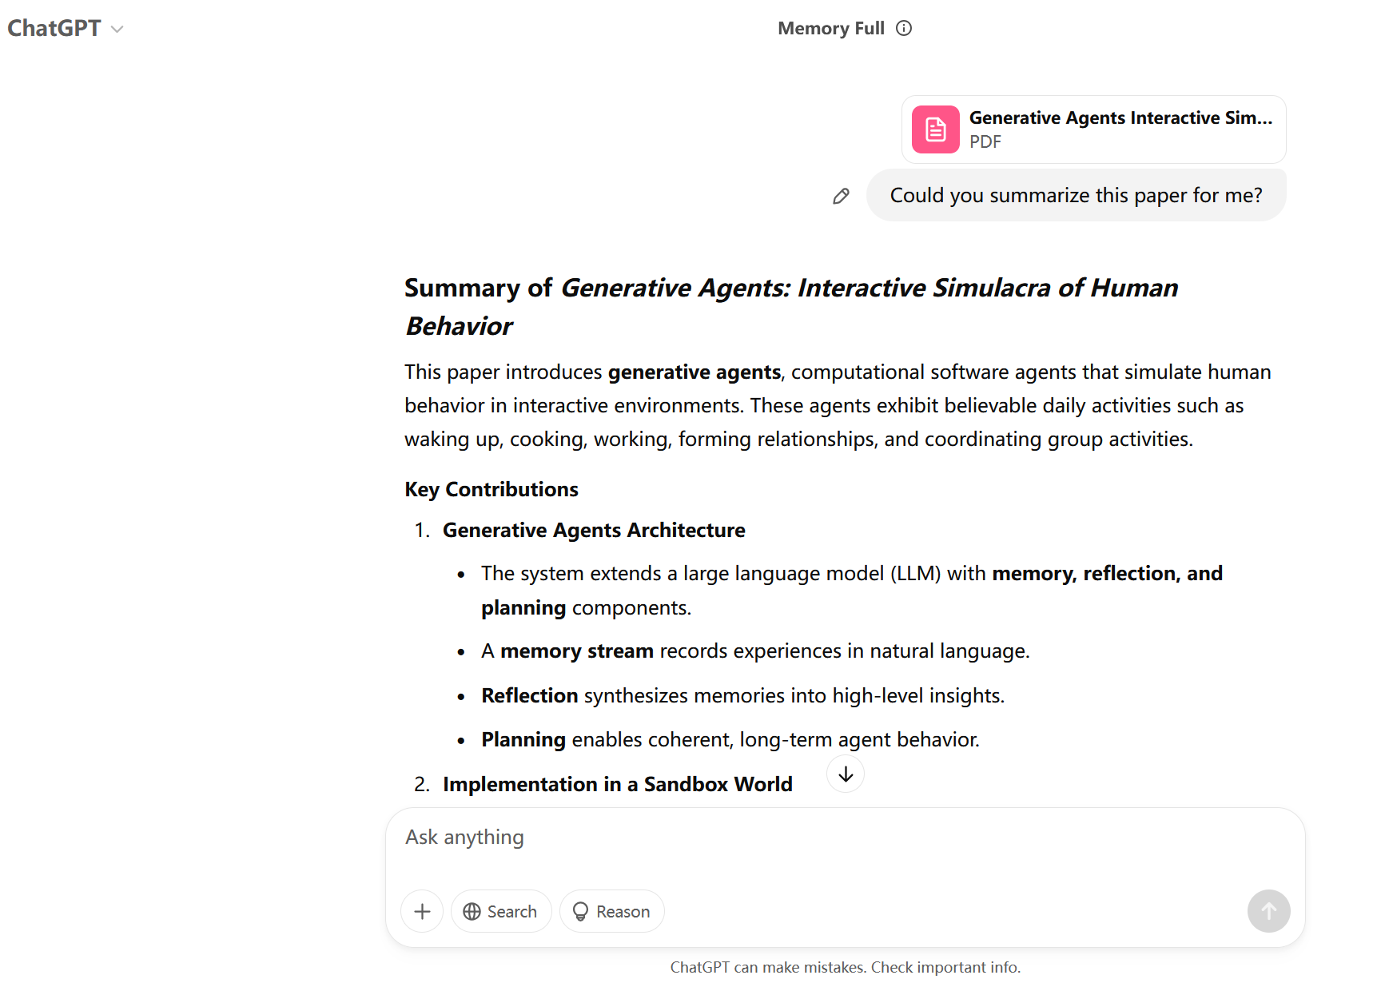
LLM as Reading aid –Part I
You can upload documents (or just copy paste text) for LLM to read. It can summarize and explain parts for you.
Best for:
1. Reading research papers
2. Reading books that are from different fields
other than your area of expertise (I recently
used ChatGPT to help me read and understand
《庄子》, works great!)

Slide 10
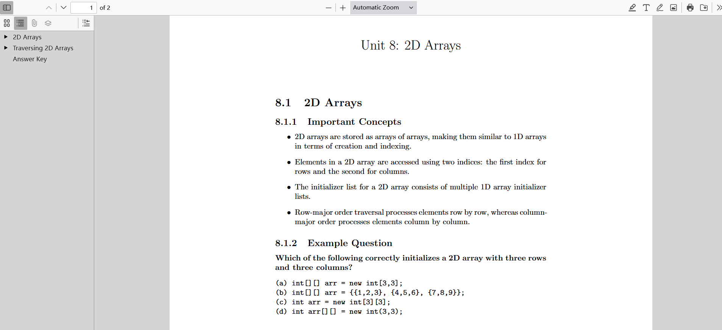
Part II- Using the document uploader capability to generate AP review guide
You can upload the study guide from CollegeBoard chapter by chapter and ask it to generate a summary for you
However, don’t forget to read it to ensure it did not make things up
Notes:
Example prompt:
I'd like you to create a APCSA study guide for me using the canvas tool. I will upload the official collegeboard study guide, and you can pick out the important concepts and make one example question from each subunit. The example question should cover concepts which students often have trouble with. Please attach the answer of all practice questions at the end of the guide. Please write in Latex format. Here is the sample format I want you to follow:

Slide 11
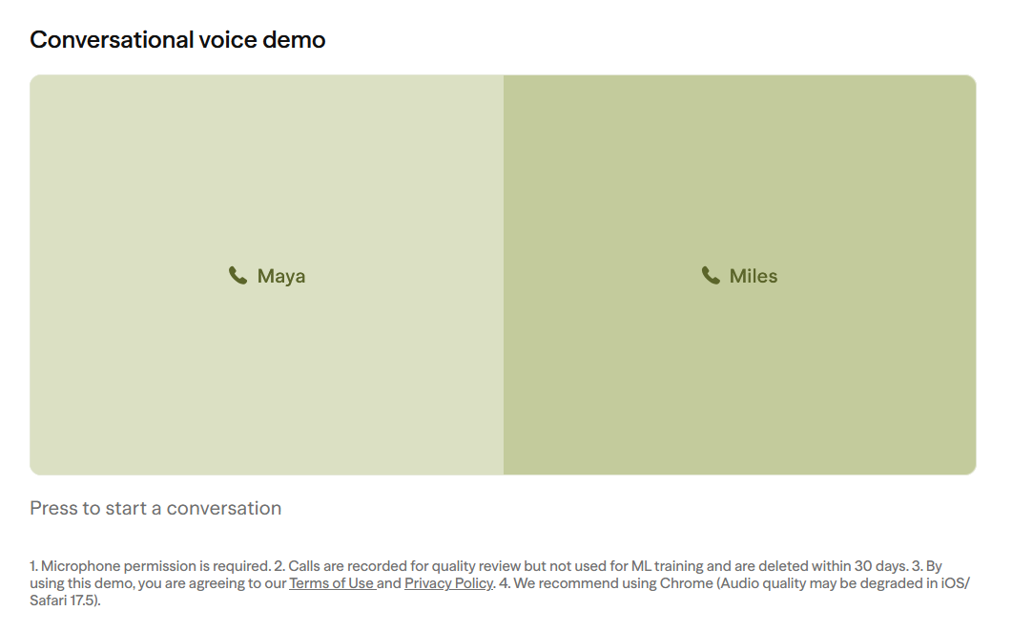
LLM with Voice Capability
Some LLMs (e.g. seasame AI) allow you to talk to it using voice. I haven’t found them to be particularly helpful for me.
Best for:
1. Maybe some interesting projects?
2. Maybe you don’t want to type out your questions?
3. Conversation partner?

Slide 12
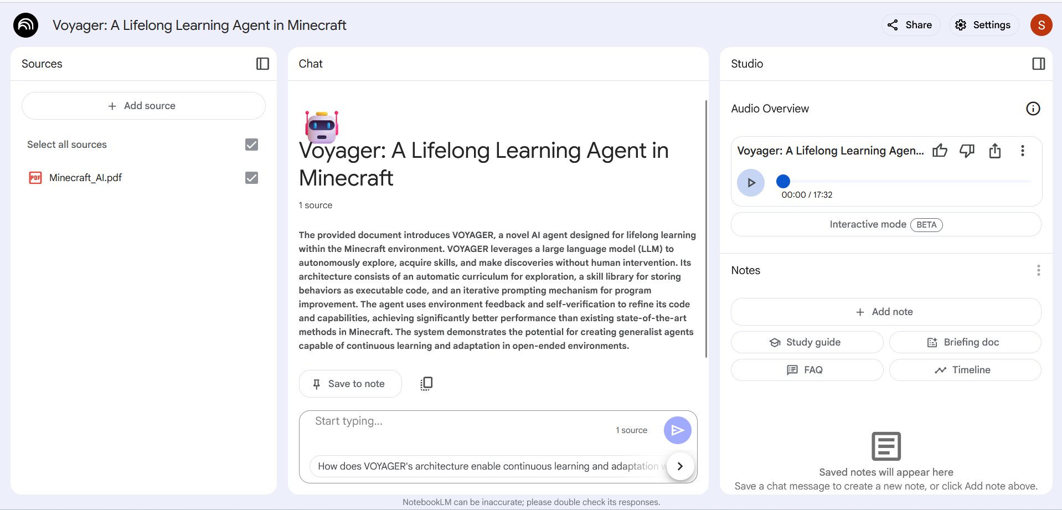
LLM as Podcast
Google NotebookLM can generate a podcast based on the document you feed to it. This feature is quite interesting, I tried it with some research paper that’s hard to understand, and listening to two people talking about it maybe helped a little bit :p

Slide 13
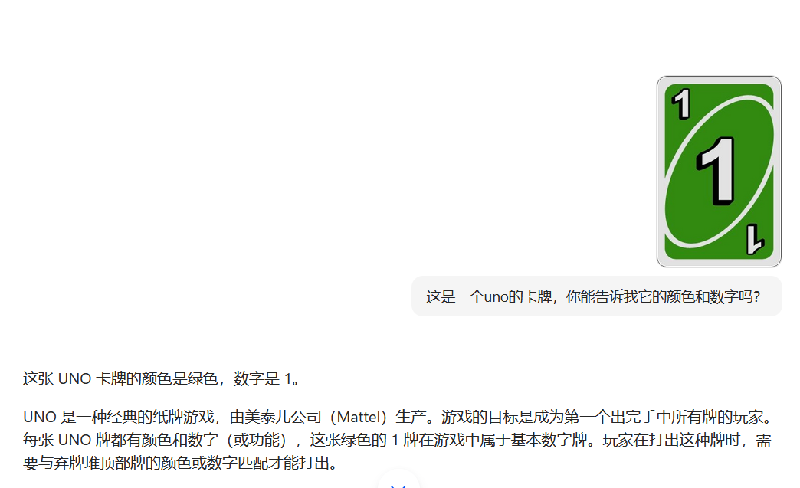
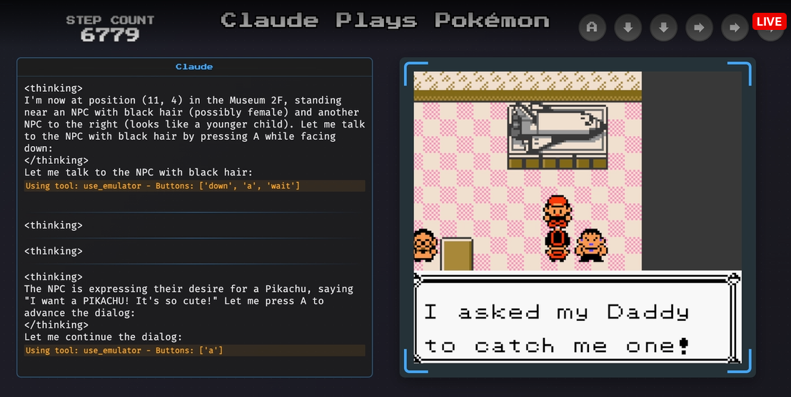
LLM with Image understanding capability
Some LLMs allow you to input images and it can understand information in the image
Some use cases:
1. Game agents
2. OCR (i.e. extract texts from images)

Slide 14
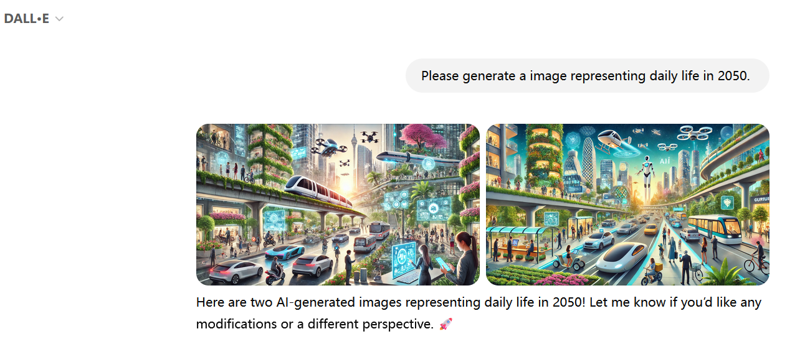
LLM as image generator (Text to Image)
Models like Stable diffusion, ChatGPT DALL.E can generate images based on text prompt
Best for:
1. Design work

Slide 15
LLM as video generator (Text to Video)
Models like Google Veo 2

Slide 16
LLM as music generator

Slide 17
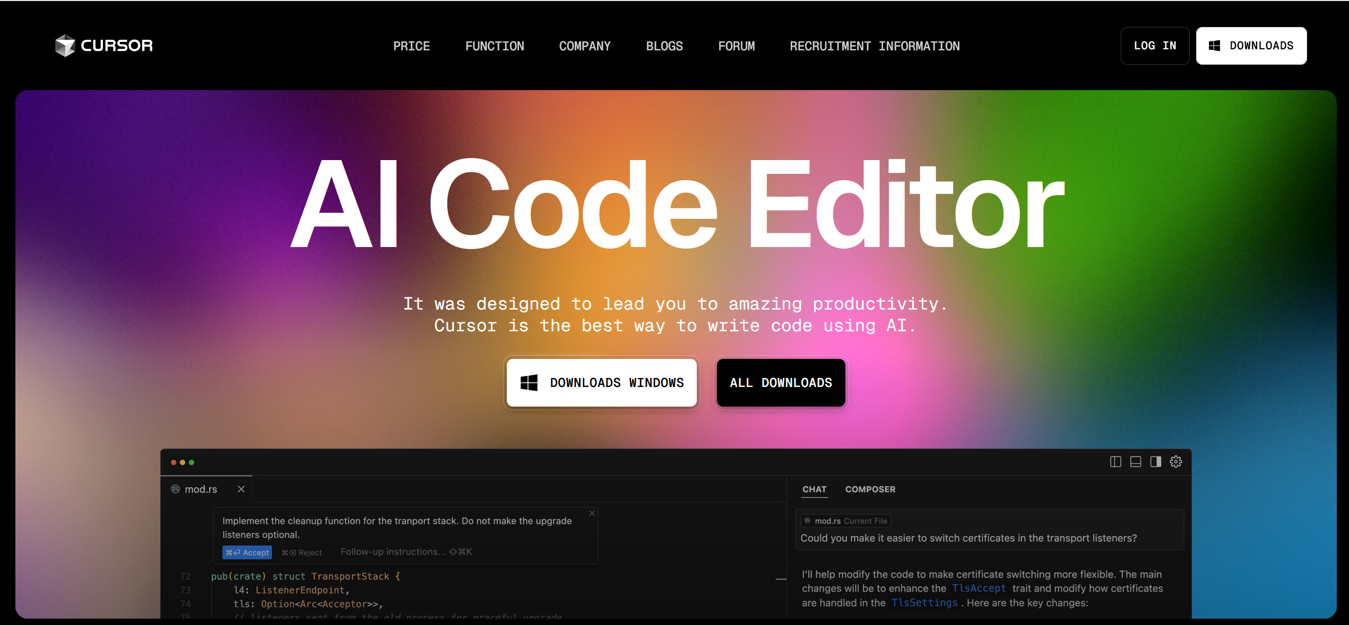
LLM as Coding Assistant (Advanced)
There are LLM-integrated IDEs such as Cursor that can make coding much easier and more convenient.
Best for:
Coding

Slide 18
Customized LLMs (Advanced use)
You can write system prompt for LLM to change its identify from a helpful assistant to whoever you want it to be, and to answer in a certain manner. Some researches found that such “cosplay” improves response quality.
Ex: In our Pokemon game AI, we told Deepseek that it is the “Best Pokemon Trainer in the World”. We hope it will give better responses.

